Slide 1
One Way Hash Function
This lecture is mainly based on the power point slides by Professor Lawrie Brown.
Notes:
Zili Shao

Slide 2
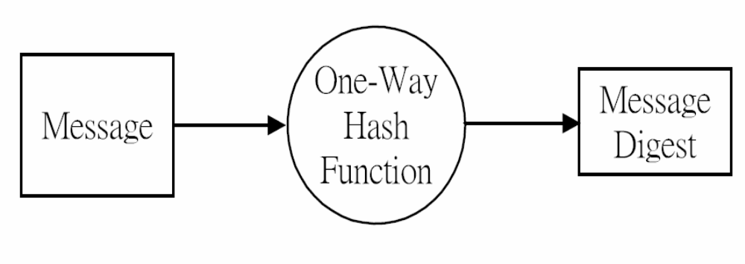
Hash and Message Digest
CEG 260, Meilin Liu
Notes:
Zili Shao
All security policies and mechanisms rest on assumptions; we’ll examine some in later chapters, most notably Chapter 22, Malicious Logic. Here is a taste of the assumptions.
Policies: as these define security, they have to define security correctly for the particular site. For example, a web site has to be available, but if the security policy does not mention availability, the definition of security is inappropriate for the site. Also, a policy may not specify whether a particular state is “secure” or “non-secure.” This ambiguity causes problems.
Mechanisms: as these enforce policy, they must be appropriate. For example, cryptography does not assure availability, so using cryptography in the above situation won’t work. Further, security mechanisms rely on supporting infrastructure, such as compilers, libraries, the hardware, and networks to work correctly. Ken Thompson’s modified C preprocessor (see the example on p. 615) illustrates this point very well.

Slide 3
Hash Functions
condenses arbitrary message to fixed size
  h = H(M)
usually assume that the hash function is public and not keyed
  MAC which is keyed
hash used to detect changes to message
can use in various ways with message
most often to create a digital signature
CEG 260, Meilin Liu
Notes:
Zili Shao
A variation on the message authentication code is the one-way hash function. As with the message authentication code, a hash function accepts a variable-size message M as input and produces a fixed-size output, referred to as a hash code H(M). Unlike a MAC, a hash code does not use a key but is a function only of the input message. The hash code is also referred to as a message digest or hash value.

Slide 4
Requirements for Hash Functions
can be applied to any sized message M
produces fixed-length output h
is easy to compute h=H(M) for any message M
given h is infeasible to find x s.t. H(x)=h
  one-way property
given x is infeasible to find y s.t. H(y)=H(x)
  weak collision resistance
is infeasible to find any x,y s.t. H(y)=H(x)
  strong collision resistance
CEG 260, Meilin Liu
Notes:
Zili Shao
These are the specifications for good hash functions. Essentially it must be extremely difficult to find 2 messages with the same hash, and the hash should not be related to the message in any obvious way (ie it should be a complex non-linear function of the message). There are quite a few similarities in the evolution of hash functions & block ciphers, and in the evolution of the design requirements on both.

Slide 5
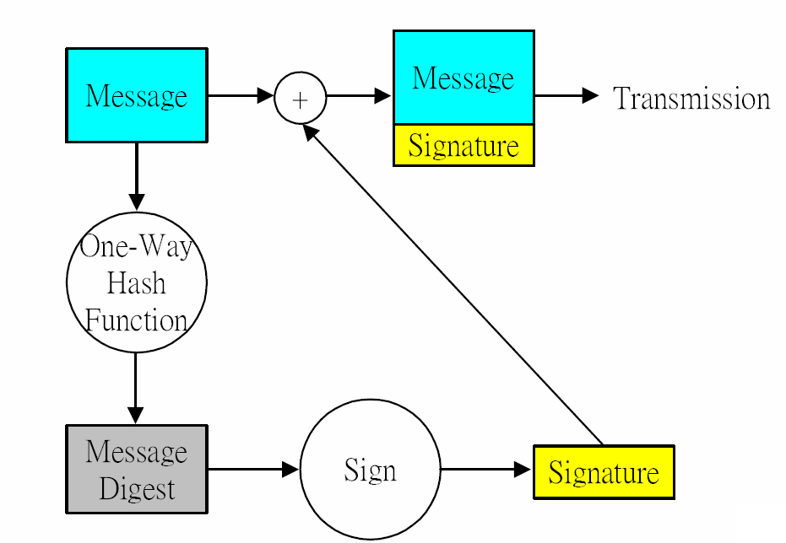
Message Digest and Signature
CEG 260, Meilin Liu
Notes:
Zili Shao
The actual key exchange for either party consists of raising the others "public key' to power of their private key. The resulting number (or as much of as is necessary) is used as the key for a block cipher or other private key scheme. For an attacker to obtain the same value they need at least one of the secret numbers, which means solving a discrete log, which is computationally infeasible given large enough numbers

Slide 6
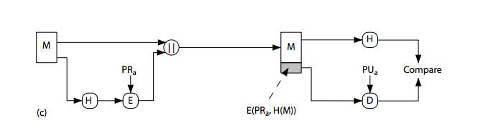
Hash Functions & Digital Signatures
CEG 260, Meilin Liu
Notes:
Zili Shao
Stallings Figure 11.5c “Basic Uses of Hash Functions” shows the hash being “signed” with the senders private key, thus forming a digital signature.

Slide 7
Simple Hash Functions
There are several proposals for simple functions
based on XOR of message blocks
not secure since can manipulate any message and either not change hash or change hash also
Bit-by-bit exclusive-OR (XOR) of every block
  C_{i} = b_{i1} xor b_{i2} xor . . . xor b_{im}
  Produces a simple parity for each bit position and is known as a longitudinal redundancy check
  Reasonably effective for random data as a data integrity check
Perform a one-bit circular shift on the hash value after each block is processed
  Has the effect of randomizing the input more completely and overcoming any regularities that appear in the input
CEG 260, Meilin Liu
Notes:
Zili Shao
All hash functions operate using the following general principles. The input (message, file,etc.) is viewed as a sequence of n-bit blocks, processed one block at a time in an iterative fashion to produce an n-bit hash function. Can construct a range of possible simple hash functions by just XOR’ing blocks with rotates etc. None of these are secure, since can predict how changes to message affect the resulting hash.

Slide 8
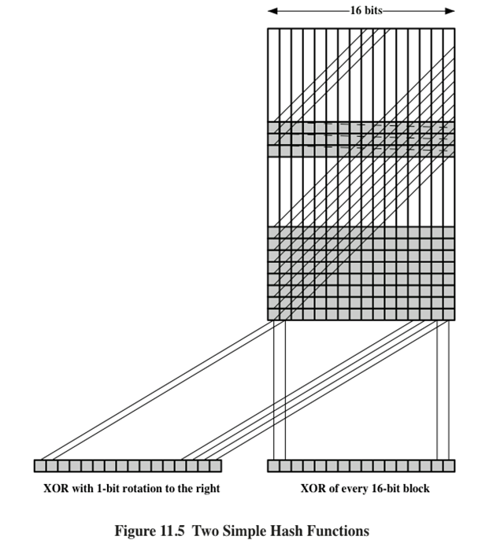

Two Simple Hash Functions
CEG 260, Meilin Liu
Notes:
Zili Shao
All hash functions operate using the following general principles. The input (message, file,etc.) is viewed as a sequence of n-bit blocks, processed one block at a time in an iterative fashion to produce an n-bit hash function. Can construct a range of possible simple hash functions by just XOR’ing blocks with rotates etc. None of these are secure, since can predict how changes to message affect the resulting hash.

Slide 9
Block Ciphers as Hash Functions
can use block ciphers as hash functions
  using H₀=0 and zero-pad of final block
  compute: H_{i} = E_{Mi} [H_{i-1}]
  and use final block as the hash value
  similar to CBC but without a key
resulting hash is too small (64-bit)
  both due to direct birthday attack
  and to “meet-in-the-middle” attack
other variants also susceptible to attack
CEG 260, Meilin Liu
Notes:
Zili Shao
A number of proposals have been made for hash functions based on using a cipher block chaining technique, but without the secret key (instead using the message blocks as keys). Unfortunately these are subject to both the birthday attack, and to a “meet-in-the-middle” attack. Thus, attention has been directed at finding other approaches to hashing.

Slide 10
Hash Functions & MAC Security
like block ciphers have:
brute-force attacks exploiting
  strong collision resistance hash have cost 2^{m/2}
    have proposal for h/w MD5 cracker
    128-bit hash looks vulnerable, 160-bits better
  MACs with known message-MAC pairs
    can either attack keyspace (cf key search) or MAC
    at least 128-bit MAC is needed for security
CEG 260, Meilin Liu
Notes:
Zili Shao
Just as with symmetric and public-key encryption, we can group attacks on hash functions and MACs into two categories: brute-force attacks and cryptanalysis.
The strength of a hash function against brute-force attacks depends solely on the length of the hash code produced by the algorithm, with cost O(2^m/2). See proposal in text for a h/w MD5 cracker.
A brute-force attack on a MAC is a more difficult undertaking because it requires known message-MAC pairs. However analysis shows cost is related to min(2^k, 2^n), similar to symmetric encryption algorithms.

Slide 11
Generic attack on C.R. functions
Let H: M → {0,1}^{m} be a hash function ( |M| >> 2^{m} )
Generic alg. to find a collision in time O(2^{m/2}) hashes
Algorithm:
Choose 2^{m/2} random messages in M: m₁, …, m₂m/2 (distinct with high probability )
For i = 1, …, 2^{m/2} compute t_{i} = H(m_{i}) ∈{0,1}^{n}
Look for a collision (t_{i} = t_{j}). If not found, got back to step 1.
How well will this work?

Slide 12
Generic attack
H: M → {0,1}^{m} . Collision finding algorithm:
Choose 2^{m/2} random elements in M: m₁, …, m₂m/2
For i = 1, …, 2^{m/2} compute t_{i} = H(m_{i}) ∈{0,1}^{m}
Look for a collision (t_{i} = t_{j}). If not found, got back to step 1.
Expected number of iteration ≈ 2
Running time: O(2^{m/2}) (space O(2^{m/2}) )
Notes:
m1 , … , m2^{n/2} are distinct with w.h.p

Slide 13
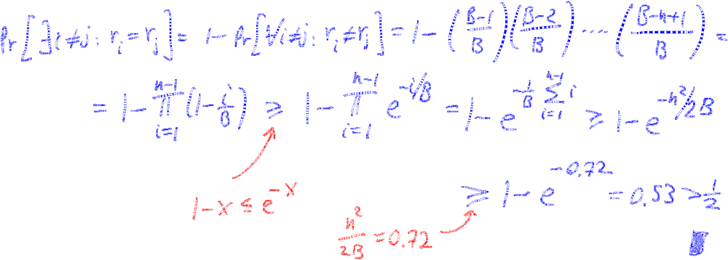

The birthday paradox
Let r₁, …, r_{n} ∈ {1,…,B} be indep. identically distributed integers.
Thm: when n= 1.2 × B^{1/2} then Pr[ ∃i≠j: r_{i} = r_{j} ] ≥ ½
Proof: (for uniform indep. r₁, …, r_{n} )

Slide 14
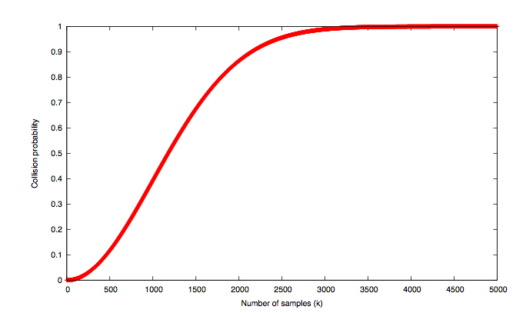
B=10⁶
# samples n

Slide 15
Hash Functions & MAC Security
cryptanalytic attacks exploit structure
  like block ciphers want brute-force attacks to be the best alternative
have a number of analytic attacks on iterated hash functions
  CV_{i} = f[CV_{i-1}, M_{i}]; H(M)=CV_{N}
  typically focus on collisions in function f
  like block ciphers is often composed of rounds
  attacks exploit properties of round functions
CEG 260, Meilin Liu
Notes:
Zili Shao
As with encryption algorithms, cryptanalytic attacks on hash functions and MAC algorithms seek to exploit some property of the algorithm to perform some attack other than an exhaustive search. The way to measure the resistance of a hash or MAC algorithm to cryptanalysis is to compare its strength to the effort required for a brute-force attack. That is, an ideal hash or MAC algorithm will require a cryptanalytic effort greater than or equal to the brute-force effort.
Cryptanalysis of hash functions focuses on the internal structure of the compression function f and is based on attempts to find efficient techniques for producing collisions for a single execution of f. Keep in mind that for any hash function there must exist collisions, but want it to be computationally infeasible to find these collisions.

Slide 16
Hash and MAC Algorithms
Hash Functions
  condense arbitrary size message to fixed size
  by processing message in blocks
  through some compression function
  either custom or block cipher based
Message Authentication Code (MAC)
  fixed sized authenticator for some message
  to provide authentication for message
  by using block cipher mode or hash function
CEG 260, Meilin Liu
Notes:
Zili Shao
Now look at important examples of both secure hash functions and message authentication codes (MACs).
Traditionally, most hash functions that have achieved widespread use rely on a compression function specifically designed for the hash function. Another approach is to use a symmetric block cipher as the compression function.
MACs also fall into two categories: some use a hash algorithm such as SHA as the core of the MAC algorithm, others use a symmetric block cipher in a cipher block chaining mode.

Slide 17
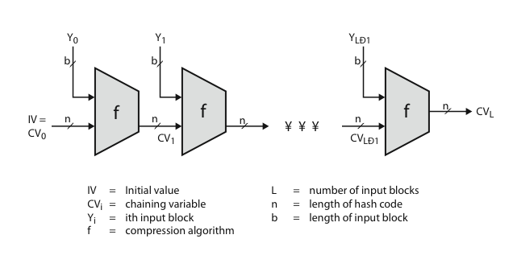
Hash Algorithm Structure
CEG 260, Meilin Liu
Notes:
Zili Shao
Most important modern hash functions follow the basic structure shown in this figure, Stallings Figure 11.9. This has proved to be a fundamentally sound structure, and newer designs simply refine the structure and add to the hash code length. Within this basic structure, two approaches have been followed in the design of the compression function, as mentioned previously, which is the basic building block of the hash function.

Slide 18
Secure Hash Algorithm
SHA originally designed by NIST & NSA in 1993
was revised in 1995 as SHA-1
US standard for use with DSA signature scheme
  standard is FIPS 180-1 1995, also Internet RFC3174
  nb. the algorithm is SHA, the standard is SHS
based on design of MD4 with key differences
produces 160-bit hash values
recent 2005 results on security of SHA-1 have raised concerns on its use in future applications
CEG 260, Meilin Liu
Notes:
Zili Shao
The Secure Hash Algorithm (SHA) was developed by the National Institute of Standards and Technology (NIST) and published as a federal information processing standard (FIPS 180) in 1993; a revised version was issued as FIPS 180-1 in 1995 and is generally referred to as SHA-1. The actual standards document is entitled Secure Hash Standard. SHA is based on the hash function MD4 and its design closely models MD4. SHA-1 produces a hash value of 160 bits. In 2005, a research team described an attack in which two separate messages could be found that deliver the same SHA-1 hash using 2^69 operations, far fewer than the 2^80 operations previously thought needed to find a collision with an SHA-1 hash [WANG05]. This result should hasten the transition to newer, longer versions of SHA.

Slide 19
Revised Secure Hash Standard
NIST issued revision FIPS 180-2 in 2002
adds 3 additional versions of SHA
  SHA-256, SHA-384, SHA-512
designed for compatibility with increased security provided by the AES cipher
structure & detail is similar to SHA-1
hence analysis should be similar
but security levels are rather higher
CEG 260, Meilin Liu
Notes:
Zili Shao
In 2002, NIST produced a revised version of the standard, FIPS 180-2, that defined three new versions of SHA, with hash value lengths of 256, 384, and 512 bits, known as SHA-256, SHA-384, and SHA-512. These new versions have the same underlying structure and use the same types of modular arithmetic and logical binary operations as SHA-1, hence analyses should be similar. In 2005, NIST announced the intention to phase out approval of SHA-1 and move to a reliance on the other SHA versions by 2010. See Stallings Table12.1 for comparative details of these algorithms.

Slide 20
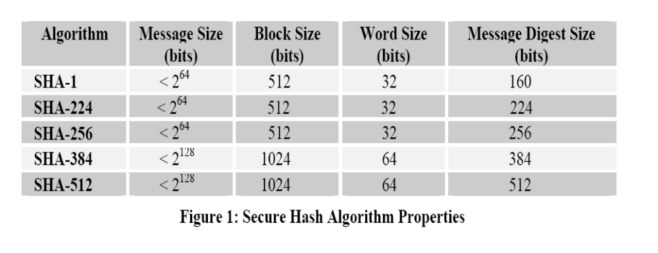
Secure Hash Algorithms
CEG 260, Meilin Liu
Notes:
Zili Shao
All security policies and mechanisms rest on assumptions; we’ll examine some in later chapters, most notably Chapter 22, Malicious Logic. Here is a taste of the assumptions.
Policies: as these define security, they have to define security correctly for the particular site. For example, a web site has to be available, but if the security policy does not mention availability, the definition of security is inappropriate for the site. Also, a policy may not specify whether a particular state is “secure” or “non-secure.” This ambiguity causes problems.
Mechanisms: as these enforce policy, they must be appropriate. For example, cryptography does not assure availability, so using cryptography in the above situation won’t work. Further, security mechanisms rely on supporting infrastructure, such as compilers, libraries, the hardware, and networks to work correctly. Ken Thompson’s modified C preprocessor (see the example on p. 615) illustrates this point very well.

Slide 21
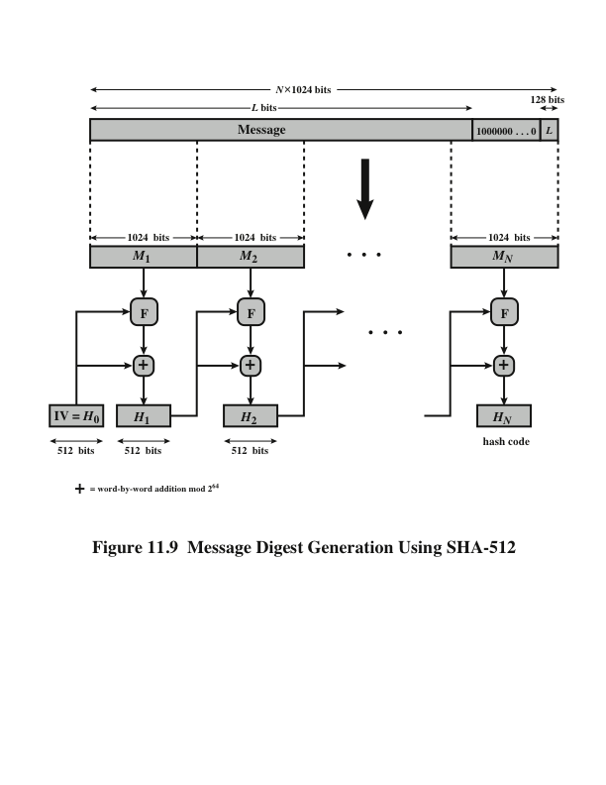
SHA-512 Overview
CEG 260, Meilin Liu
Notes:
Zili Shao
Now examine the structure of SHA-512, noting that the other versions are quite similar.
SHA-512 follows the structure depicted in Stallings Figure 12.1. The processing consists of the following steps:
• Step 1: Append padding bits
• Step 2: Append length
• Step 3: Initialize hash buffer
• Step 4: Process the message in 1024-bit (128-word) blocks, which forms the heart of the algorithm
• Step 5: Output the final state value as the resulting hash
See text for details.

Slide 22
SHA-512 Appending
Appending padding bits: 1 bit of 1 followed with 0, so that the padded message length satisfy that length mod 1024 =896.
Append length: A block of 128 bits is appended to the message. This block is treated as an unsigned 128-bit integer which contains the length of the original message before the padding.
CEG 260, Meilin Liu
Notes:
Zili Shao
The SHA-512 Compression Function is the heart of the algorithm. In this Step 4, it processes the message in 1024-bit (128-word) blocks, using a module that consists of 80 rounds, labeled F in Stallings Figure 12, as shown in Figure 12.2. Each round takes as input the 512-bit buffer value, and updates the contents of the buffer. Each round t makes use of a 64-bit value Wt derived using a message schedule from the current 1024-bit block being processed. Each round also makes use of an additive constant Kt, based on the fractional parts of the cube roots of the first eighty prime numbers. The output of the eightieth round is added to the input to the first round to produce the final hash value for this message block, which forms the input to the next iteration of this compression function, as shown on the previous slide.

Slide 23
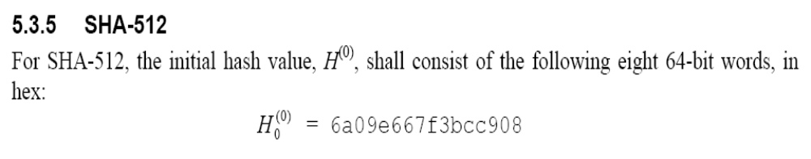
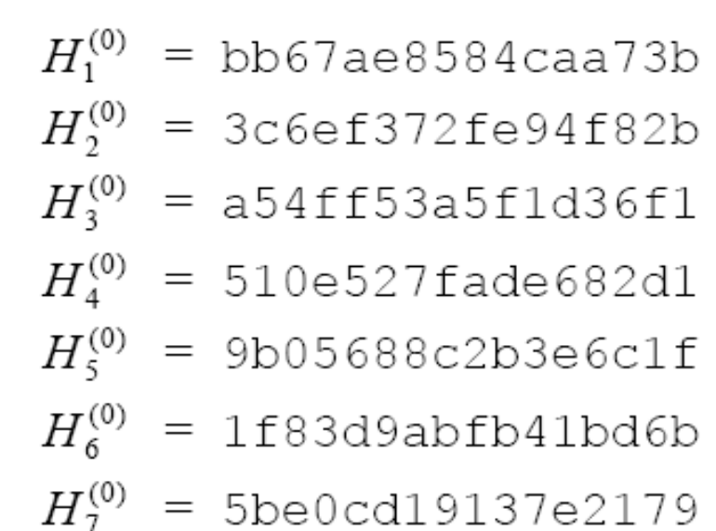
SHA-512 Initial Hash Buffer
CEG 260, Meilin Liu
Notes:
Zili Shao
Chapter 12 summary.

Slide 24
SHA-512 Compression Function
heart of the algorithm
processing message in 1024-bit blocks
consists of 80 rounds
  updating a 512-bit buffer
  using a 64-bit value Wt derived from the current message block
  and a round constant based on cube root of first 80 prime numbers
CEG 260, Meilin Liu
Notes:
Zili Shao
The SHA-512 Compression Function is the heart of the algorithm. In this Step 4, it processes the message in 1024-bit (128-word) blocks, using a module that consists of 80 rounds, labeled F in Stallings Figure 12, as shown in Figure 12.2. Each round takes as input the 512-bit buffer value, and updates the contents of the buffer. Each round t makes use of a 64-bit value Wt derived using a message schedule from the current 1024-bit block being processed. Each round also makes use of an additive constant Kt, based on the fractional parts of the cube roots of the first eighty prime numbers. The output of the eightieth round is added to the input to the first round to produce the final hash value for this message block, which forms the input to the next iteration of this compression function, as shown on the previous slide.

Slide 25
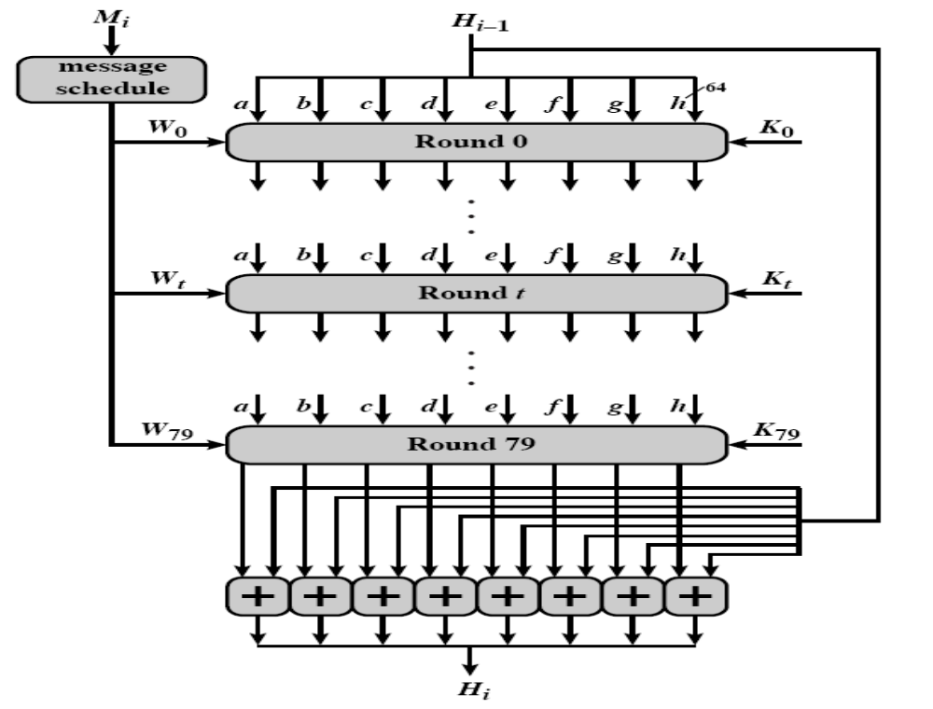
SHA-512 Processing of a Single 1024-bit Block
CEG 260, Meilin Liu
Notes:
Zili Shao
Stallings Figure 12.4 details how the 64-bit word values Wt are derived from the 1024-bit message. The first 16 values of Wt are taken directly from the 16 words of the current block. The remaining values are defined as a function of the earlier values using ROTates, SHIFTs and XORs as shown. The function elements are:
∂0(x) = ROTR(x,1) XOR ROTR(x,8) XOR SHR(x,7)
∂1(x) = ROTR(x,19) XOR ROTR(x,61) XOR SHR(x,6).

Slide 26
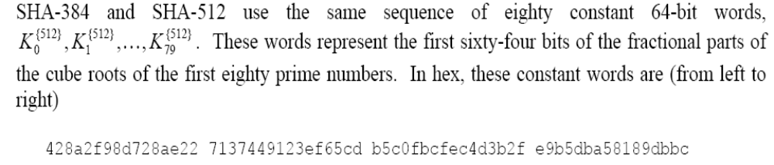
SHA-512 Round Constants K0- K79
-- The first 64 bits of the fractional parts of the cube roots of the first eighty prime numbers
CEG 260, Meilin Liu
Notes:
Zili Shao
Chapter 12 summary.

Slide 27
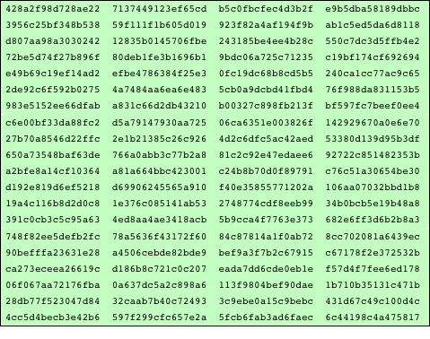
SHA-512 Round Constants K0- K79
-- The first 64 bits of the fractional parts of the cube roots of the first eighty prime numbers
CEG 260, Meilin Liu
Notes:
Zili Shao
Chapter 12 summary.

Slide 28
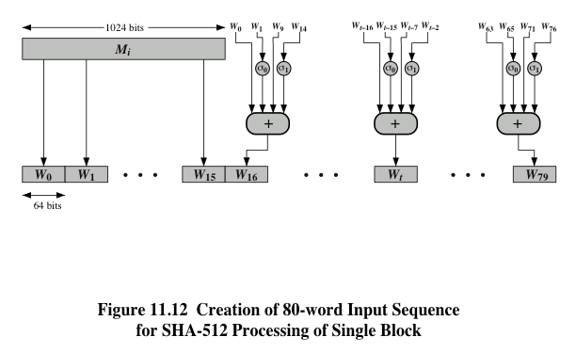
SHA-512 Round Function
CEG 260, Meilin Liu
Notes:
Zili Shao
Stallings Figure 12.4 details how the 64-bit word values Wt are derived from the 1024-bit message. The first 16 values of Wt are taken directly from the 16 words of the current block. The remaining values are defined as a function of the earlier values using ROTates, SHIFTs and XORs as shown. The function elements are:
∂0(x) = ROTR(x,1) XOR ROTR(x,8) XOR SHR(x,7)
∂1(x) = ROTR(x,19) XOR ROTR(x,61) XOR SHR(x,6).

Slide 29
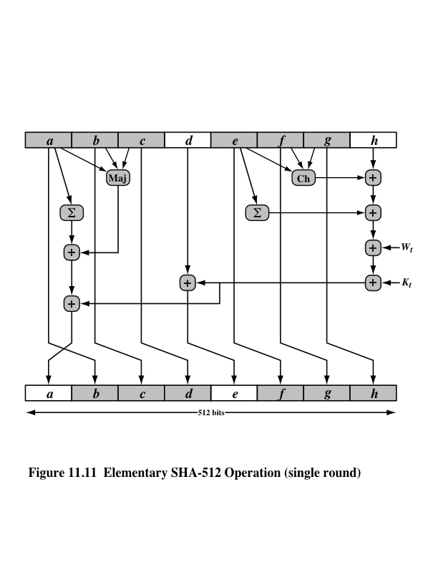
SHA-512 Round Function
CEG 260, Meilin Liu
Notes:
Zili Shao
The structure of each of the 80 rounds is shown in Stallings Figure 12.3. Each 64-bit word shuffled along one place, and in some cases manipulated using a series of simple logical functions (ANDs, NOTs, ORs, XORs, ROTates), in order to provide the avalanche & completeness properties of the hash function. The elements are:
Ch(e,f,g) = (e AND f) XOR (NOT e AND g)
Maj(a,b,c) = (a AND b) XOR (a AND c) XOR (b AND c)
∑(a) = ROTR(a,28) XOR ROTR(a,34) XOR ROTR(a,39)
∑(e) = ROTR(e,14) XOR ROTR(e,18) XOR ROTR(e,41)
+ = addition modulo 2^64
Kt = a 64-bit additive constant
Wt = a 64-bit word derived from the current 512-bit input block.

Slide 30
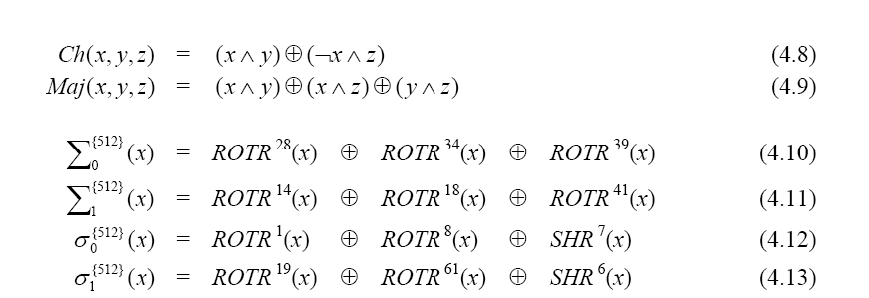
SHA-512 Functions
Addition is modolo 2^(64)
CEG 260, Meilin Liu
Notes:
Zili Shao
Chapter 12 summary.

Slide 31
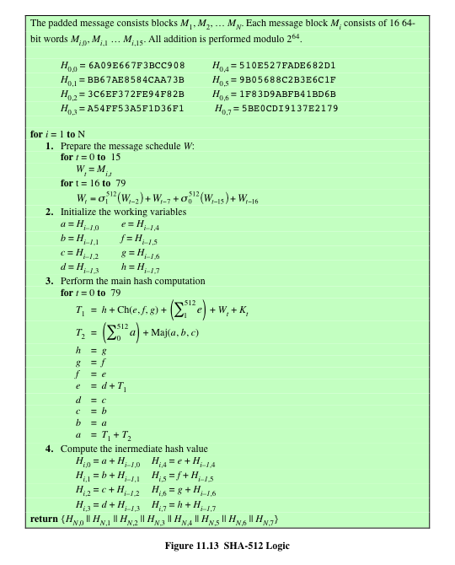
SHA-512 Logic
An Example
from FIPS 180-2
CEG 260, Meilin Liu
Notes:
Zili Shao
Chapter 12 summary.

Slide 32
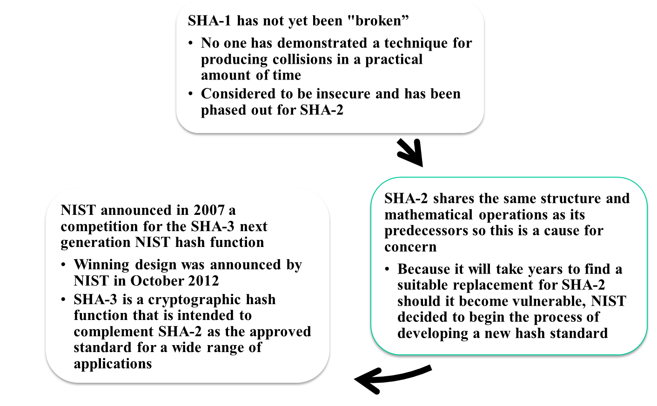
SHA-3
Notes:
As of this writing, the Secure Hash Algorithm (SHA-1) has not yet been “broken.”
That is, no one has demonstrated a technique for producing collisions in a practical
amount of time. However, because SHA-1 is very similar, in structure and in the
basic mathematical operations used, to MD5 and SHA-0, both of which have been
broken, SHA-1 is considered insecure and has been phased out for SHA-2.
SHA-2, particularly the 512-bit version, would appear to provide unassailable
security. However, SHA-2 shares the same structure and mathematical operations
as its predecessors, and this is a cause for concern. Because it will take years to find
a suitable replacement for SHA-2, should it become vulnerable, NIST decided to
begin the process of developing a new hash standard.
Accordingly, NIST announced in 2007 a competition to produce the next generation
NIST hash function, to be called SHA-3. The winning design for SHA-3
was announced by NIST in October 2012. SHA-3 is a cryptographic hash function
that is intended to complement SHA-2 as the approved standard for a wide range
of applications.
Appendix V looks at the evaluation criteria used by NIST to select from
among the candidates for AES, plus the rationale for picking Keccak, which was
the winning candidate. This material is useful in understanding not just the SHA-3
design but also the criteria by which to judge any cryptographic hash algorithm.

Slide 33
The Sponge Construction
Underlying structure of SHA-3 is a scheme referred to by its designers as a sponge construction
Takes an input message and partitions it into fixed-size blocks
Each block is processed in turn with the output of each iteration fed into the next iteration, finally producing an output block
The sponge function is defined by three parameters:
  f = the internal function used to process each input block
  r = the size in bits of the input blocks, called the bitrate
  pad = the padding algorithm
Notes:
The underlying structure of SHA-3 is a scheme referred to by its designers as a
sponge construction [BERT07, BERT11]. The sponge construction has the same
general structure as other iterated hash functions (Figure 11.8). The sponge function
takes an input message and partitions it into fixed-size blocks. Each block is
processed in turn with the output of each iteration fed into the next iteration, finally
producing an output block.
The sponge function is defined by three parameters:
f = the internal function used to process each input block
r = the size in bits of the input blocks, called the bitrate
pad = the padding algorithm

Slide 34
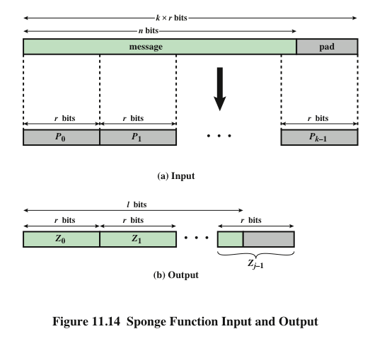
Notes:
A sponge function allows both variable length input and output, making it a
flexible structure that can be used for a hash function (fixed-length output), a pseudorandom
number generator (fixed-length input), and other cryptographic functions.
Figure 11.14 illustrates this point.
The sponge specification proposes [BERT11] proposes
two padding schemes:
• Simple padding: Denoted by pad10*, appends a single bit 1 followed by the
minimum number of bits 0 such that the length of the result is a multiple of the
block length.
• Multirate padding: Denoted by pad10*1, appends a single bit 1 followed by
the minimum number of bits 0 followed by a single bit 1 such that the length of
the result is a multiple of the block length. This is the simplest padding scheme
that allows secure use of the same f with different rates r .

Slide 35
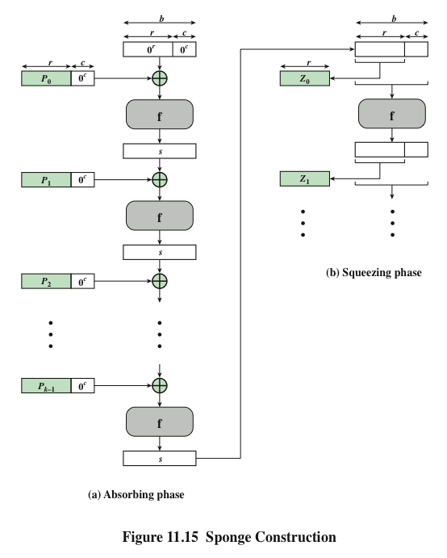
Notes:
Figure 11.15 shows the iterated structure of the sponge function. The sponge
construction operates on a state variable s of b = r + c bits, which is initialized to all
zeros and modified at each iteration. The value r is called the bitrate. This value is
the block size used to partition the input message. The term bitrate reflects the fact
that r is the number of bits processed at each iteration: the larger the value of r , the
greater the rate at which message bits are processed by the sponge construction.
The value c is referred to as the capacity . A discussion of the security implications of
the capacity is beyond our scope. In essence, the capacity is a measure of the achievable
complexity of the sponge construction and therefore the achievable level of
security. A given implementation can trade claimed security for speed by increasing
the capacity c and decreasing the bitrate r accordingly, or vice versa. The default
values for Keccak are c = 1024 bits, r = 576 bits, and therefore b = 1600 bits.

Slide 36
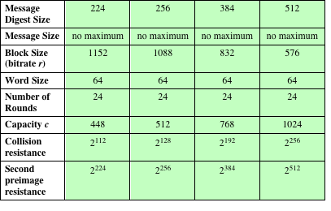
Table 11.5
SHA-3 Parameters
Notes:
Table 11.5 shows
the supported values of r and c . As Table 11.5 shows, the hash function security associated
with the sponge construction is a function of the capacity c .

Slide 37
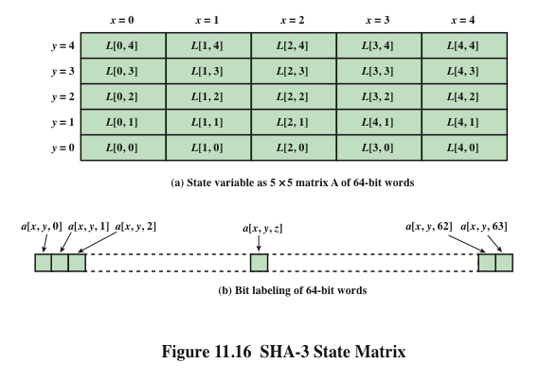
Notes:
We now examine the iteration function Keccak-f used to process each successive
block of the input message. Recall that f takes as input a 1600-bit variable s consisting
of r bits, corresponding to the message block size followed by c bits, referred to as the
capacity. For internal processing within f , the input state variable s is organized as a
5 * 5 * 64 array a . The 64-bit units are referred to as lanes . For our purposes, we generally
use the notation a [x , y , z ] to refer to an individual bit with the state array. When
we are more concerned with operations that affect entire lanes, we designate the
5 * 5 matrix as L [x , y ], where each entry in L is a 64-bit lane. The use of indices
within this matrix is shown in Figure 11.16. Thus, the columns are labeled x = 0
through x = 4, the rows are labeled y = 0 through y = 4, and the individual bits
within a lane are labeled z = 0 through z = 63.
The mapping between the bits of s
and those of a is
s [64(5y + x ) + z ] = a [x , y , z ]
We can visualize this with respect to the matrix in Figure 11.16. When treating
the state as a matrix of lanes, the first lane in the lower left corner, L [0, 0], corresponds
to the first 64 bits of s . The lane in the second column, lowest row, L [1, 0],
corresponds to the next 64 bits of s . Thus, the array a is filled with the bits of s starting
with row y = 0 and proceeding row by row.

Slide 38
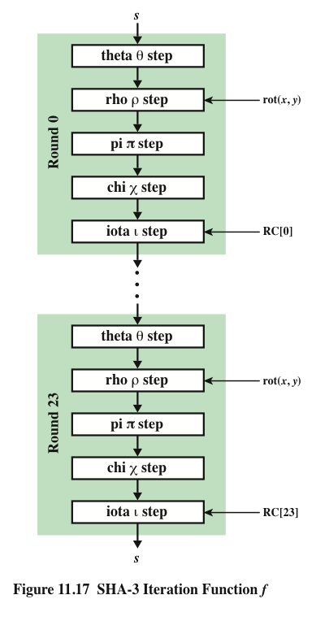
SHA-3
Iteration Function f
Notes:
The function f is executed once for each input block of the message
to be hashed. The function takes as input the 1600-bit state variable and converts
it into a 5 * 5 matrix of 64-bit lanes. This matrix then passes through 24 rounds of
processing. Each round consists of five steps, and each step updates the state matrix
by permutation or substitution operations. As shown in Figure 11.17, the rounds are
identical with the exception of the final step in each round, which is modified by a
round constant that differs for each round.

Slide 39
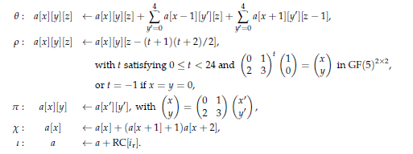
SHA-3 Iteration Function f
Notes:
Figure 11.18.a illustrates the operation on L [3, 2]. The same operation is performed
on all of the other lanes in the matrix.

Slide 40
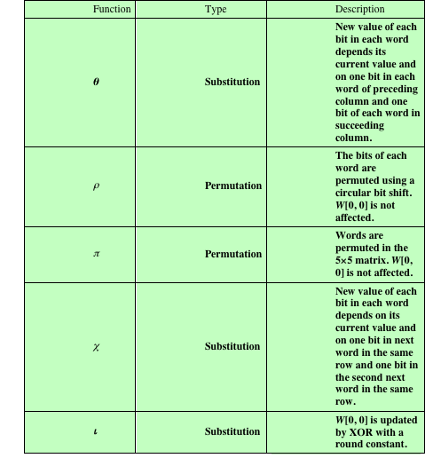
Table 11.6
Step Functions
in SHA-3
Notes:
Table 11.6 summarizes the operation of the five steps. The steps have a simple
description leading to a specification that is compact and in which no trapdoor
can be hidden. The operations on lanes in the specification are limited to bitwise
Boolean operations (XOR, AND, NOT) and rotations. There is no need for table
lookups, arithmetic operations, or data-dependent rotations. Thus, SHA-3 is easily
and efficiently implemented in either hardware or software.

Slide 41
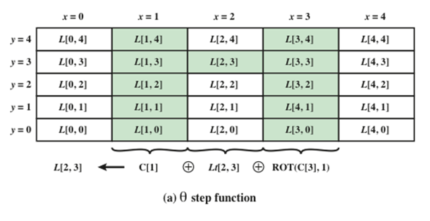
Theta step Function
C[x]=L[x,0] XOR L[x,1] XOR L[x,2]
XOR L[x,3] XOR L[x,4]
Each of the 1600 state bits is replaced by the XOR of 11 bits
the 5-bit to the left of the bit
the 5-bit to the right and “1 position to the front” of the bit.
Notes:
Figure 11.18.a illustrates the operation on L [3, 2]. The same operation is performed
on all of the other lanes in the matrix.

Slide 42
Rho step and Pi step
Rho: a[x,y,z] ← a[x,y,z], if x=y=0
Rho: a[x,y,z] ← a[x,y,(z – (t+1)(t+2)/2)], 0=<t<=23,
And
t
1
x
0 1
( )
( )
( )
=
2 3
0
y
x=0
x=1
x=2
x=3
x=4
y=4
18 | 2 | 61 | 56 | 14
41 | 45 | 15 | 21 | 8
3 | 10 | 43 | 25 | 39
36 | 44 | 6 | 55 | 20
0 | 1 | 62 | 28 | 27
y=3
y=2
y=1
y=0
Notes:
Figure 11.18.a illustrates the operation on L [3, 2]. The same operation is performed
on all of the other lanes in the matrix.

Slide 43
Rho step and Pi step
Rho: a[x,y,z] ← a[x,y,z], if x=y=0
Rho: a[x,y,z] ← a[x,y,(z – (t+1)(t+2)/2)], 0=<t<=23,
Rho step operates on words of length 64 bits (can be stored in a register)
Input: A[x,y], x, y =0,1,2,3,4
Output: B[x,y]
Rho-step: Rotate -- each word is rotated by a fixed number of positions
Z[x,y] = rotate (A[x,y], r[x,y]): Here r[x,y] is table entries.
Pi step: Permutate the rotated words.
B[y,2x+3y] = Z[x,y], x, y =0,1,2,3,4
Notes:
Figure 11.18.a illustrates the operation on L [3, 2]. The same operation is performed
on all of the other lanes in the matrix.

Slide 44
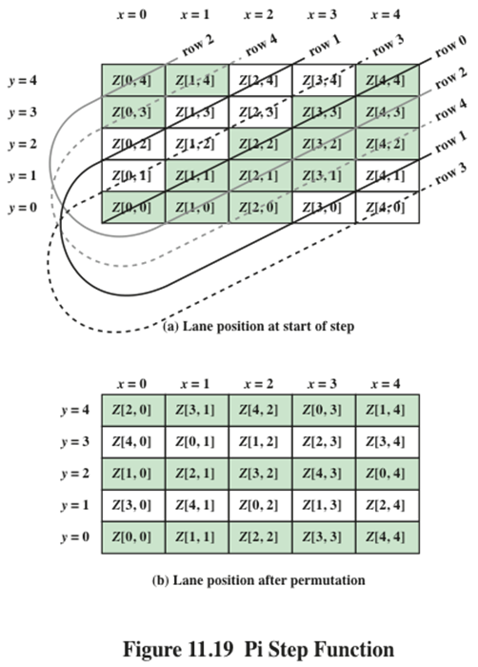
Pi step Function
Pi: a[x,y] ← a[x’,y’]
x
0 1
x’
( )
( )
( )
=
2 3
y’
y
Notes:
Figure 11.18.a illustrates the operation on L [3, 2]. The same operation is performed
on all of the other lanes in the matrix.

Slide 45
Rho step and Pi step: Example
Rho step:
Example: Input word A[3,1]
Rho step: Z[3,1] = rot (A[3,1], 55)
Pi step:
B[1, 2*3+3*1 mod 5] = B[1,4] =Z[3,1]
Notes:
Figure 11.18.a illustrates the operation on L [3, 2]. The same operation is performed
on all of the other lanes in the matrix.

Slide 46
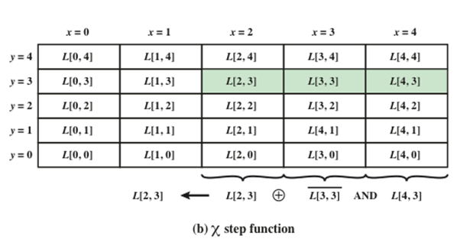
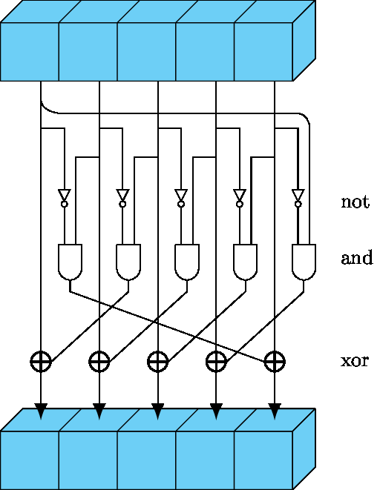
Chi step Function
Chi step: the only linear step
Input: B[x,y]
Output: S[x,y]
S[x,y] = B[x,y] XOR (B’ [x+1,y] AND B[x+2,y]
Notes:
Figure 11.18.a illustrates the operation on L [3, 2]. The same operation is performed
on all of the other lanes in the matrix.

Slide 47
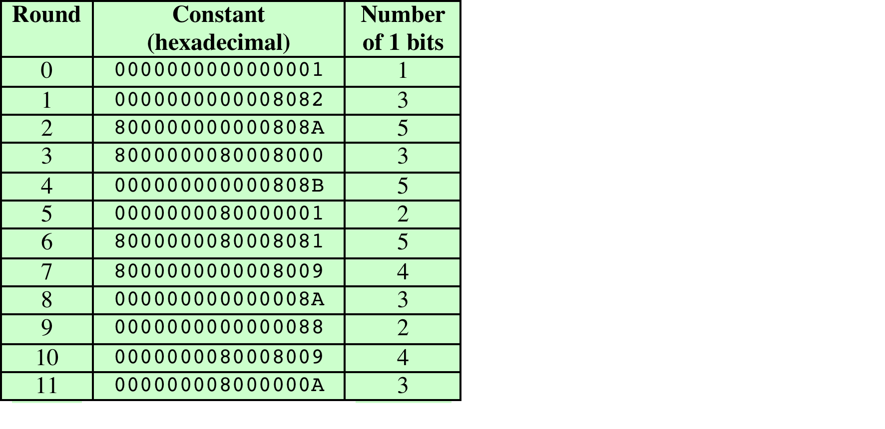
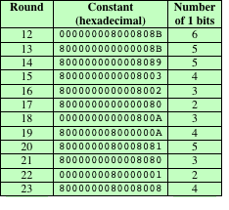
Iota step Function
Iota step: Add constants from constant table to word A[0,0]
L[0,0]=L[0,0] XOR RC[ir], 0=<ir<=23
Notes:
Figure 11.18.a illustrates the operation on L [3, 2]. The same operation is performed
on all of the other lanes in the matrix.

Slide 48
Summary
have considered:
  hash functions
    uses, requirements, security
  hash functions based on block ciphers
  SHA-1, SHA-2, SHA-3
Notes:
Chapter 11 summary.

